Slide 1
F2019-Sp2020 Callout

Slide 2
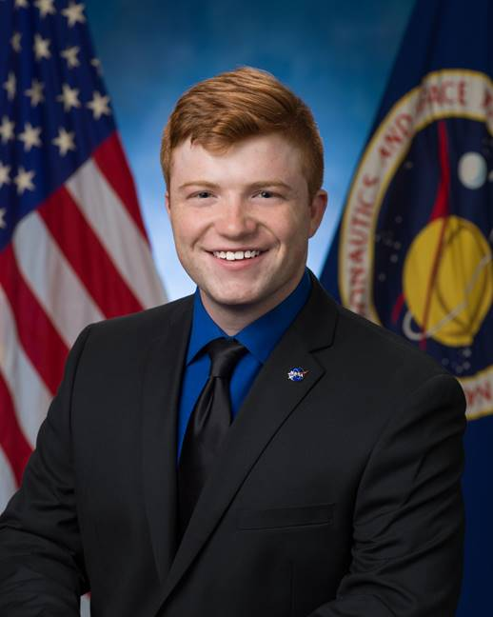
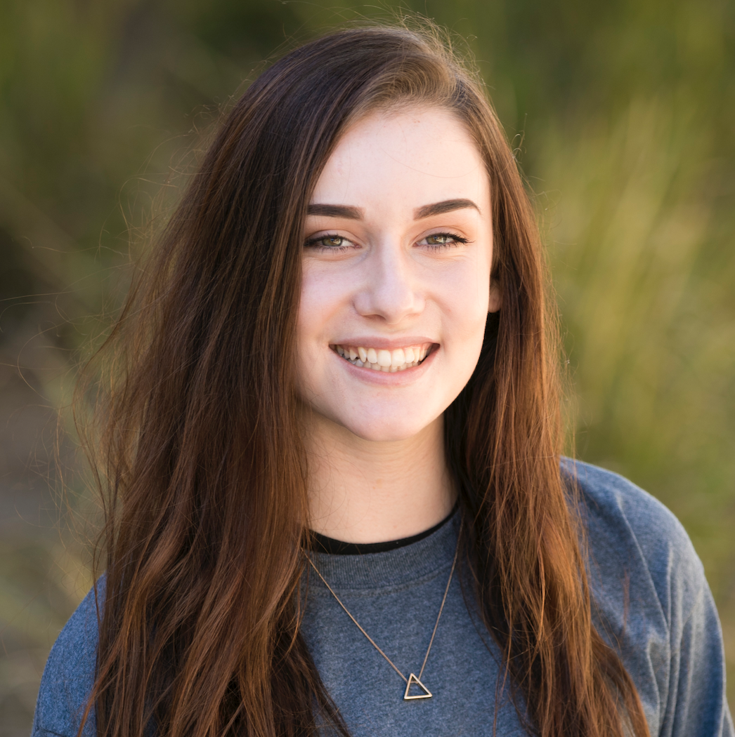
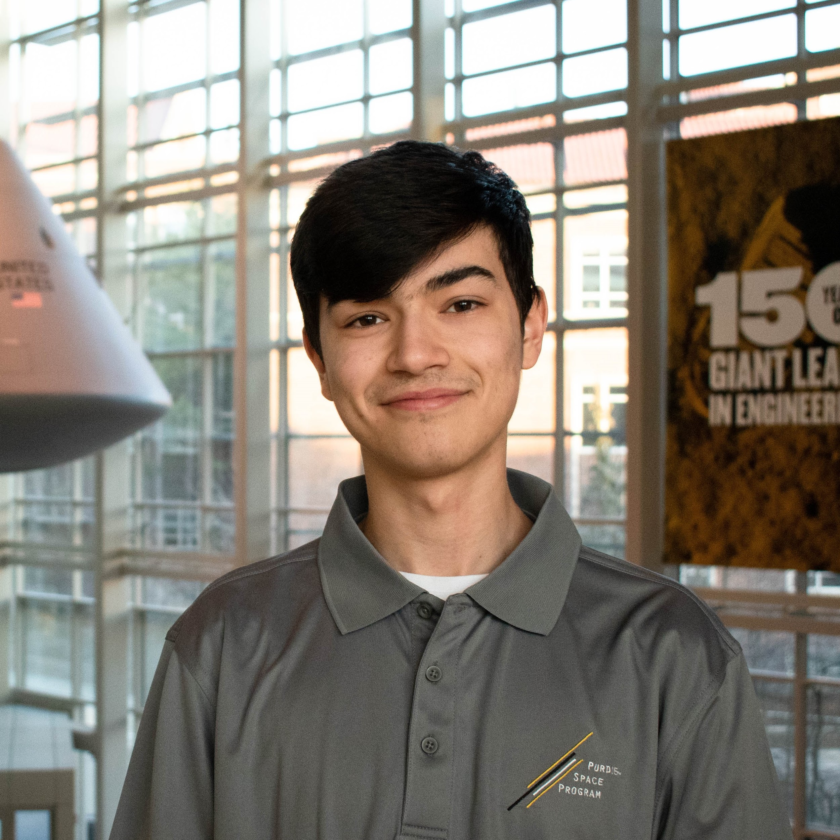
Who are we?
President/Program Director
Jon Webb
Operations Director
Emily Anderson
Treasurer
Sean Heapy
Chief Design Engineer
Colin Samuels
Chief Systems Engineer
Aaron Baum
Director of Research & Dev.
Matt Powell

Slide 3
120 Members
$40,000
14 Test Flights
representing AeroE, MechE, ECE, Krannert, and more
in cumulative funding since F2016
reaching a maximum altitude of 27,000m

Slide 4
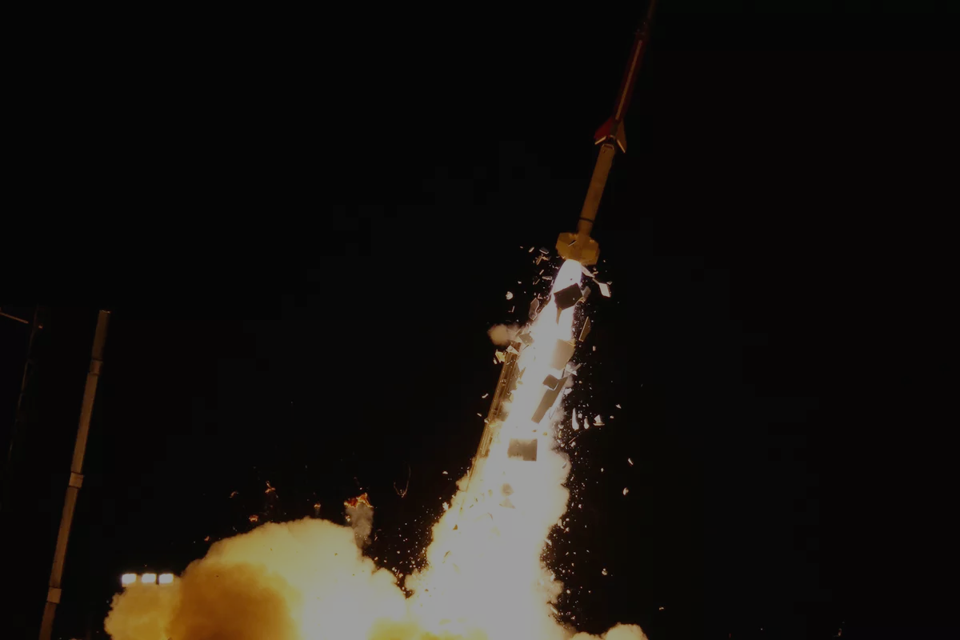
Our Mission:
“To foster technical and professional skills of all members by designing, building, and testing innovative solutions to complex problems in the space and defense industry with a specific focus on orbital insertion techniques”

Slide 5
Our Mission - Simplified:
We’re shooting rockets from balloons to put satellites into
【﻿ｓｐａｃｅ】

Slide 6
A Brief History
2015
2016
2016
2017
2019
2019
Orbital Begins
Rocket Test
LOC Test
Balloon Test
HAPSIS Alpha
HAPSIS I
Purdue Orbital is founded, collegiate space race begins
The first advanced-level rocket is launched from a standard launch platform.
Advanced-level rocket is launched off the first iteration of the LOC system.
Flight Systems performs their first polyethylene High Altitude Balloon test.
Dry run of HAPSIS I assembly, launch, and recovery procedures
Purdue Orbital performs first ever minimum system launch

Slide 7
Overall Team Breakdown
Technical
Focuses on development and fabrication of the various subsystems and their components
E.g. Payload, flight systems, mission analysis
Operations and Enterprise
Focuses on the social, administrative, and professional aspects of the organization
E.g. Team development, finances, outreach

Slide 8
All Hands Meetings
Mondays 7:30-9pm in ARMS B098
Wednesdays 5:30-7:30pm in PHYS 223
Mainly focused on hands-on work and cross-team collaboration time
Occasional team announcements and milestone updates at the beginning

Slide 9
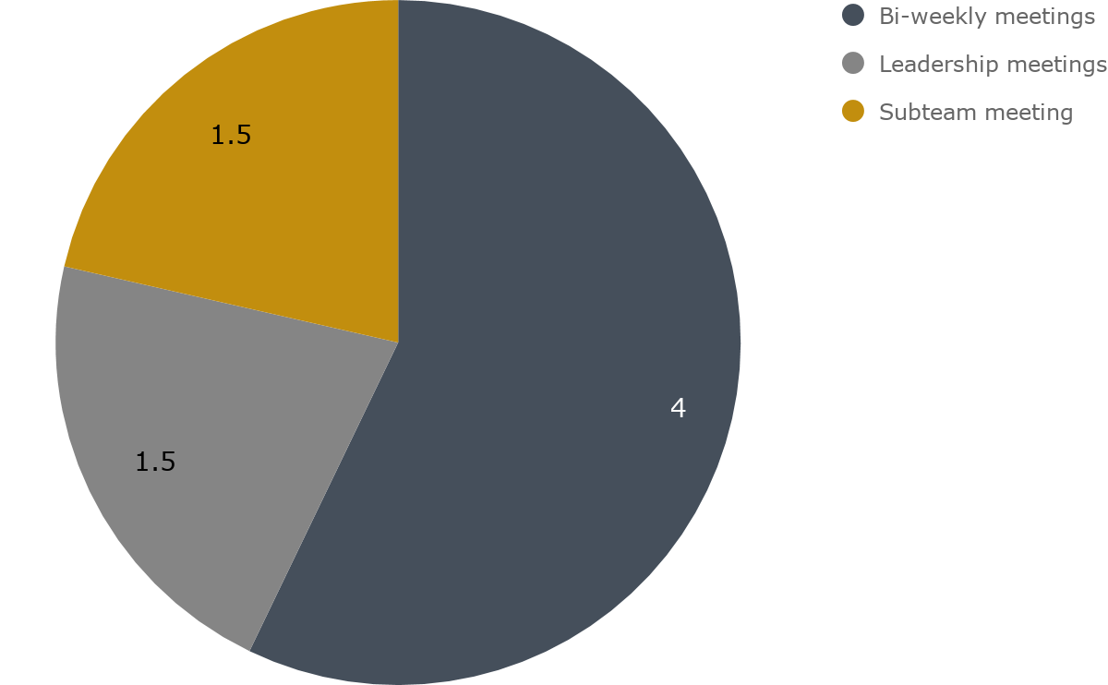
Time Commitment: 4-7hr Weekly

Slide 10
How to Join
Apply
Fill out the questionnaire and submit your resume
Interview
Find the subteam that fits your skills and abilities
Onboard
Join Slack, access the Drive, and get started on your new team!

Slide 11
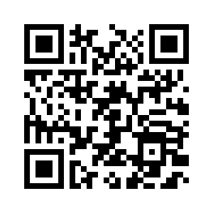
New Member Application Details
$10 membership due (semesterly)
Ask the Executives and Design Leads about work
Visit purdueorbital.com/go-orbital/
Application open until Thursday, August 29th at 11:59PM
In-person & phone interviews starting Friday, August 30th
First All-Hands Meeting on Wednesday, September 4th from 5:30-7:30PM in PHYS 223
https://forms.gle/D31yizP5gAcYQMCa8

Slide 12
Technical
Team Breakdown
Design & Manufacturing
Research & Development
Systems

Slide 13
Design & Manufacturing
Flight Systems
Balloon system, ballistic deployment device, recovery SOP
Launch Structure
Physical interface b/t balloon and rocket, structure stability
Commercial Rocket
Off-the-shelf rocket testing, rocketry certification
Avionics
Onboard flight computer, sensor package, controls
Ground Station
Hardware and software for telecommunication
Payload
Hardware carried by balloon or rocket launch vehicle

Slide 14
Research & Development
Mission Design
Model and simulate launch trajectories, staging, and orbital parameters
Guidance, Navigation, and Control (GNC)
Develop attitude control system (ACS) to orient and guide rocket
Propulsion
Design propulsion system for orbital rocket
Special Projects
Research future issues and define high level solutions

Slide 15
Systems
Flight Operations
Logistics and procedure leading up to launch, on-site safety and system verification
Verification & Validation
System tests and procedures, tracking subteam progress, intersystem junctions, project and legal documentation oversight

Slide 16
Operations Team Breakdown
Team Development
Outreach
Enterprise Division

Slide 17
Outreach
Organizes and coordinates outreach events in and around campus
E.g. Apollo 11 Events, Purdue Space Day, Purdue Foundry Events, etc.

Slide 18
Team Development
Organizes technical skill sessions, and professional/social development opportunities
E.g. Post-Design Review dinner, CAD/CAM crash courses, social events

Slide 19
Enterprise Division
Manages the administration of Purdue Orbital as an organization and finances associated with project development
E.g. Press kits and releases, merchandising and branding, university and commercial relationships

Slide 20
Why Choose Orbital?
Enhance your technical and professional skills
Fast-paced and challenging work
Participate in novel technological development
Work alongside experienced aerospace enthusiasts

Slide 21
Notes:
Some of our employers/contributors. Be sure to tie in with last slide/our network

Slide 22
Questions?

Slide 23
New Member Application Details
$10 membership due (semesterly)
Ask the Executives and Design Leads about work
Visit purdueorbital.com/go-orbital/
Application open until Thursday, August 29th at 11:59PM
In-person & phone Interviews starting Friday, August 30th
First All-Hands Meeting on Wednesday, September 4th from 5:30-7:30PM in PHYS 223
https://forms.gle/D31yizP5gAcYQMCa8

